Slide 1
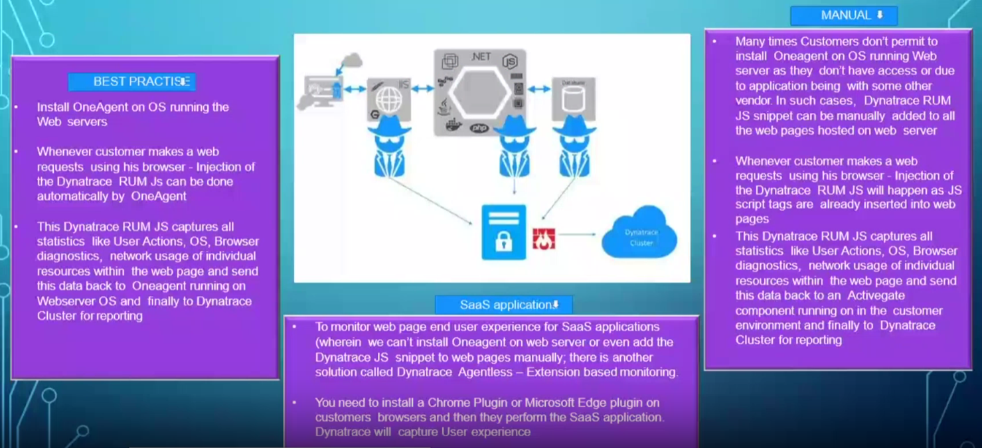
Rum working on dynatrace

Slide 2
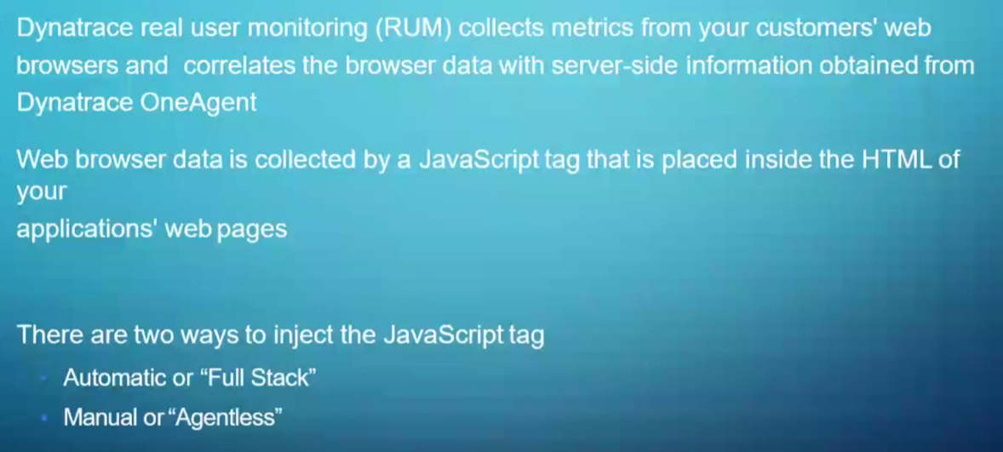
Rum working on dynatrace

Slide 3
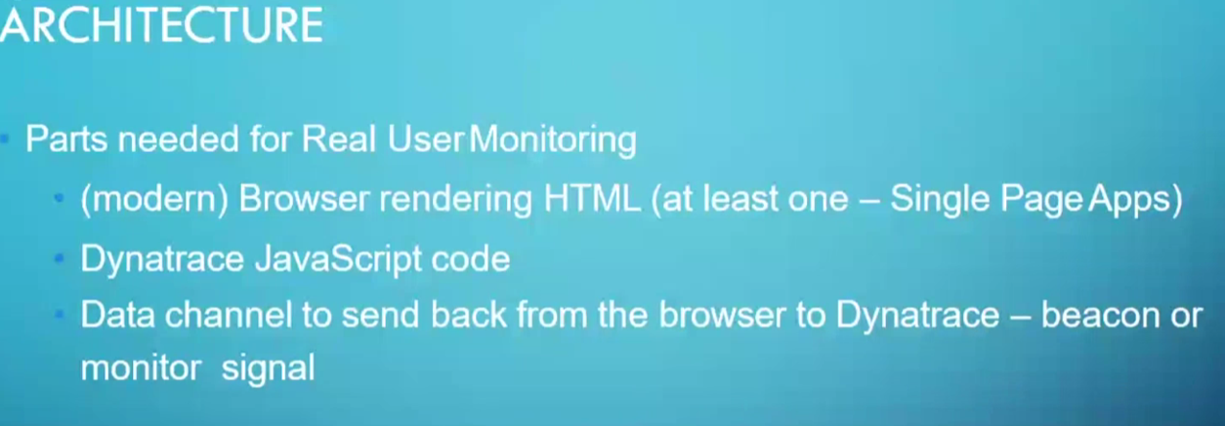
Rum working on dynatrace

Slide 4
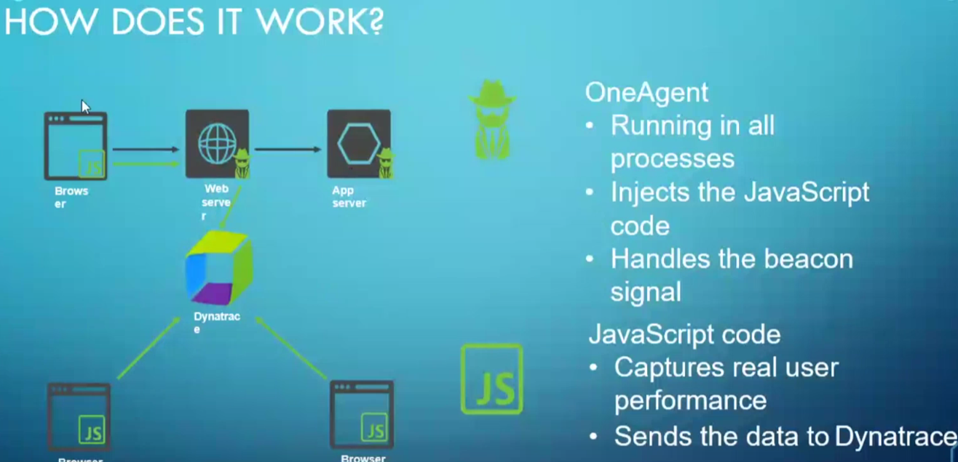
Rum working on dynatrace

Slide 5
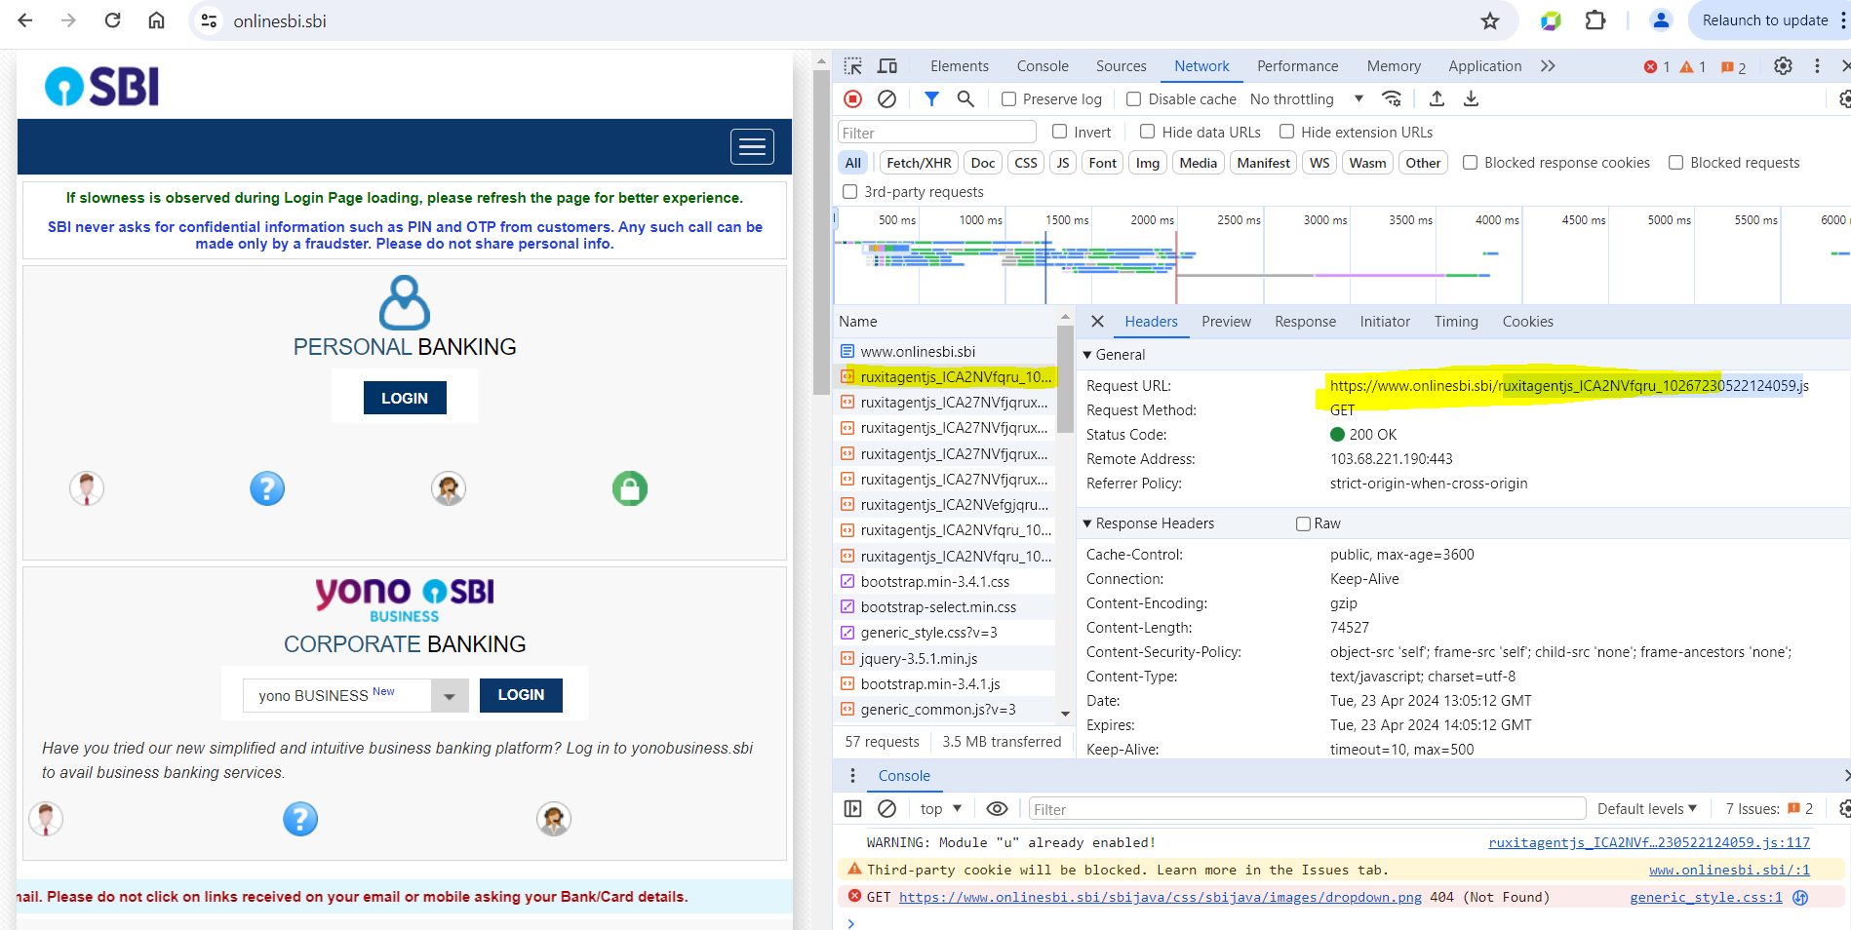
Example of web monitoring through one agent java script tag-autoinjection

Slide 6
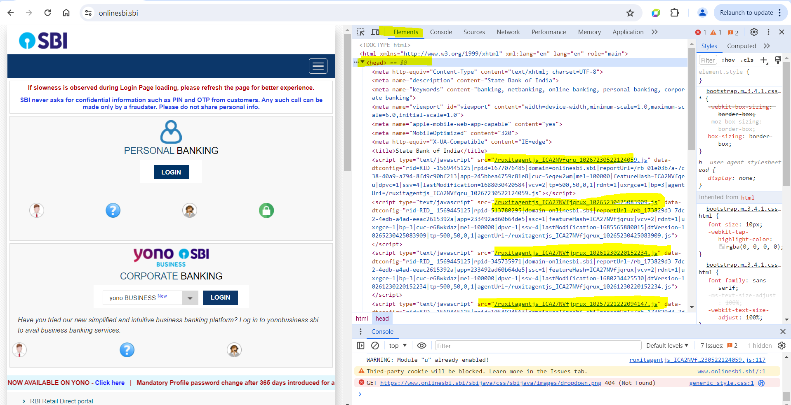
Example of web monitoring through one agent java script tag-autoinjection

Slide 7
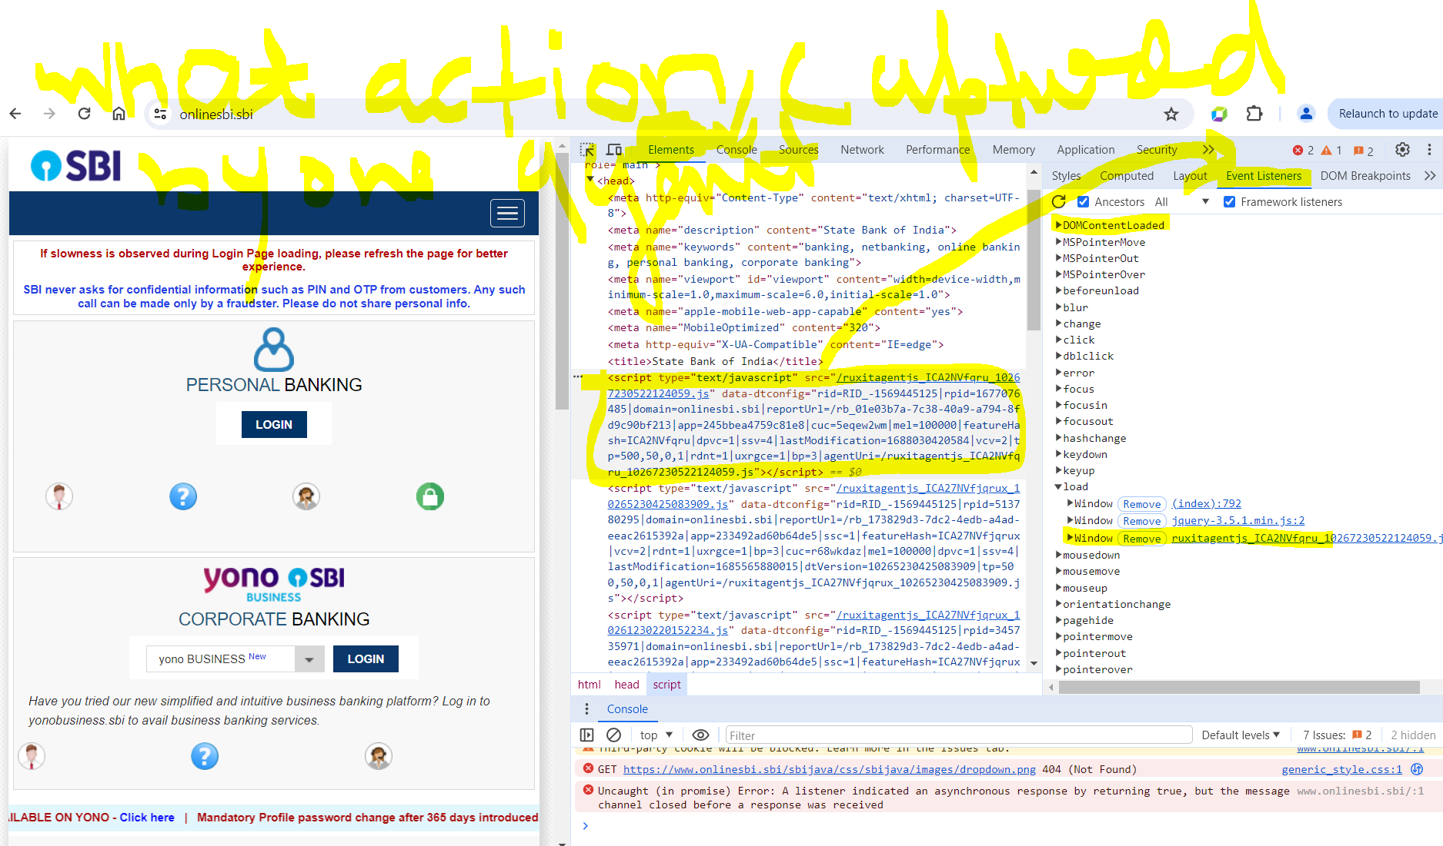
Example of web monitoring through one agent java script tag-autoinjection

